Slide 1
L3. Conjugate Models

Slide 2
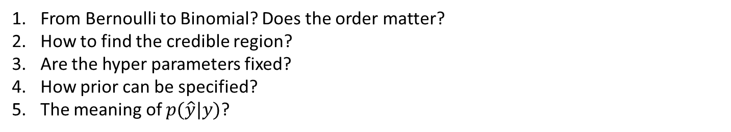
Questions from last lecture
From Bernoulli to Binomial? Does the order matter?
How to find the credible region?
Are the hyper parameters fixed?
How prior can be specified?
The meaning of $p(\hat{y}|y)$?

Slide 3

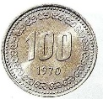

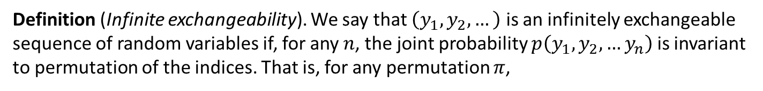
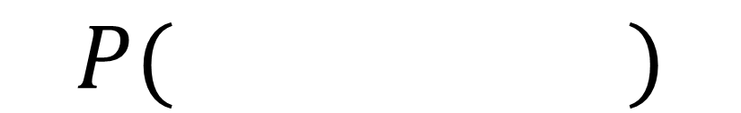
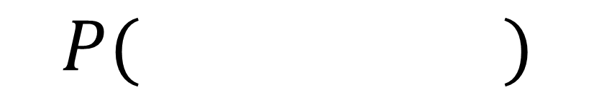



Exchangeability
=
$$P( )$$
$$P( )$$
Definition (Infinite exchangeability). We say that $\left(y_{1}, y_{2},…\right)$ is an infinitely exchangeable sequence of random variables if, for any $n$, the joint probability $p\left(y_{1}, y_{2},…y_{n}\right)$ is invariant to permutation of the indices. That is, for any permutation $π$,
$$p_{Y}\left(y_{1}, y_{2},…y_{n}\right)=p_{Y}\left(y_{π_{1}}, y_{π_{2}},…, y_{π_{n}}\right)$$
I
R.V.s are independent and identically distributed (i.i.d)
E
Random variables are infinitely exchangeability
I
E
$$P\left(R,R,B,B,B\right)=P\left(B,R,B,B,R\right)$$
Check!!
Exchangeable
$$P\left(t_{2}=R|t_{1}=R\right)≠P\left(t_{2}=R|t_{1}=B\right)$$
Not independent

Slide 4



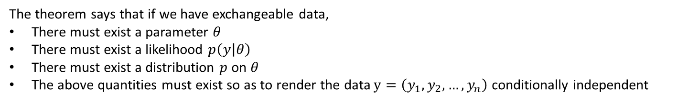
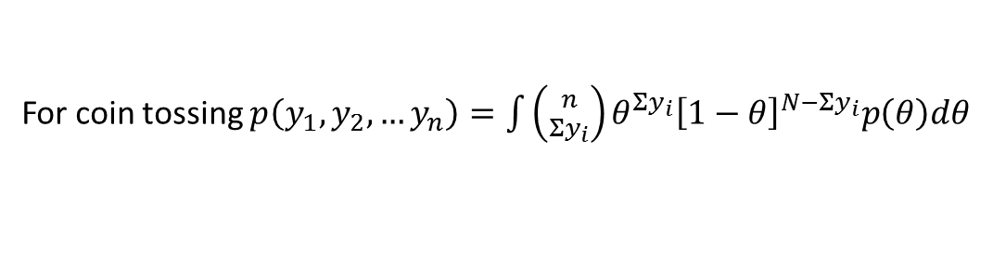
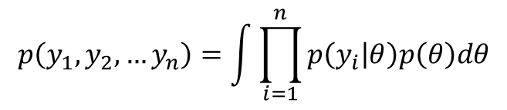

Exchangeability
$$θ$$
$$y_{1}$$
$$y_{2}$$
$$y_{n}$$
Theorem (De Finetti, 1930s). A sequence of random variables $\left(y_{1}, y_{2},…\right)$ is infinitely exchangeable iff, for all $n$,
$$p\left(y_{1}, y_{2},…y_{n}\right)=\int{\prod_{i=1}^{n}{p\left(y_{i} | θ\right)p\left(θ\right)dθ}}$$
For coin tossing $p\left(y_{1}, y_{2},…y_{n}\right)=\int{\left({n \atop Σy_{i}}\right)θ^{Σy_{i}}{\left[1−θ\right]}^{N−Σy_{i}}p\left(θ\right)dθ}$
The theorem says that if we have exchangeable data,
There must exist a parameter $θ$
There must exist a likelihood $p\left(y | θ\right)$
There must exist a distribution $p$ on $θ$
The above quantities must exist so as to render the data $y=\left(y_{1},y_{2},…, y_{n}\right)$ conditionally independent
Prior (Bayesian approach) is suggested by the data being exchangeable

Slide 5
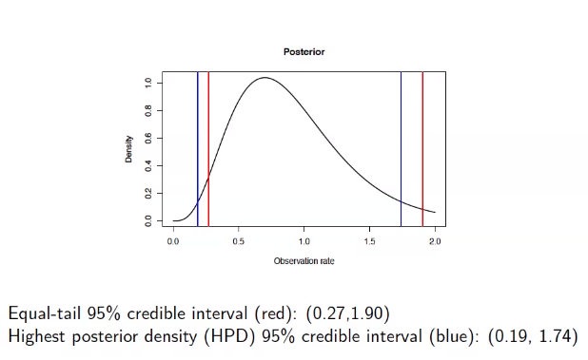
Credible region

Slide 6
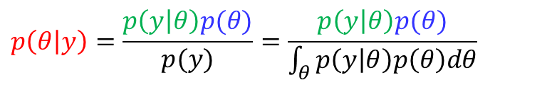
Priors
$$p\left(θ | y\right)=\frac{p\left(y | θ\right)p(θ)}{p(y)}=\frac{p\left(y | θ\right)p(θ)}{\int_{θ}^{ }{p\left(y | θ\right)p\left(θ\right)dθ}}$$
Non-informative prior (objective prior, vague prior, reference prior…)
Weekly informative prior
Informative prior (subjective prior)

Slide 7

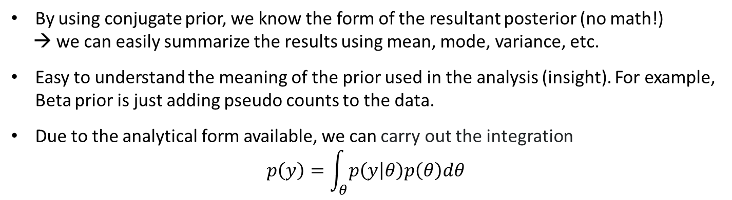

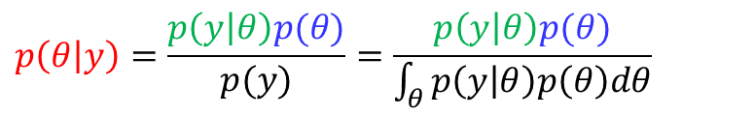



Conjugacy
$$p\left(θ | y\right)=\frac{p\left(y | θ\right)p(θ)}{p(y)}=\frac{p\left(y | θ\right)p(θ)}{\int_{θ}^{ }{p\left(y | θ\right)p\left(θ\right)dθ}}$$
From the Bayes rule,
$$𝒫$$
$$ℱ$$
$$𝒫$$
Prior
+
=
$p\left(θ | y\right)∈𝒫$ for all $p\left(∙ | θ\right)∈ℱ$and $p(∙)∈𝒫$
Likelihood
Posterior
→ $𝒫$ is conjugate for $ℱ$
Same form of dist.
If the posterior is a distribution that is of the same family as our prior
→ the prior is conjugate to the likelihood.
Advantages
By using conjugate prior, we know the form of the resultant posterior (no math!)
→ we can easily summarize the results using mean, mode, variance, etc.
Easy to understand the meaning of the prior used in the analysis (insight). For example, Beta prior is just adding pseudo counts to the data.
Due to the analytical form available, we can carry out the integration
$$p\left(y\right)=\int_{θ}^{ }{p\left(y | θ\right)p\left(θ\right)dθ}$$

Slide 8
Conjugate pairs
Likelihood | Prior | Posterior
Binomial | Beta | Beta
Negative Binomial | Beta | Beta
Geometric | Beta | Beta
Poisson | Gamma | Gamma
Exponential | Gamma | Gamma
Normal (mean unknown) | Normal | Normal
Normal (variance unknown) | Inverse Gamma | Inverse Gamma
Normal (mean and variance unknown) | Normal-Gamma | Normal-Gamma
Multinomial | Dirichlet | Dirichlet
Single
parameter
model
Multi
parameters
model

Slide 9
Conjugate pairs
Likelihood | Prior | Posterior
Binomial | Beta | Beta
Negative Binomial | Beta | Beta
Geometric | Beta | Beta
Poisson | Gamma | Gamma
Exponential | Gamma | Gamma
Normal (mean unknown) | Normal | Normal
Normal (variance unknown) | Inverse Gamma | Inverse Gamma
Normal (mean and variance unknown) | Normal-Gamma | Normal-Gamma
Multinomial | Dirichlet | Dirichlet
Single
parameter
model
Multi
parameters
model

Slide 10
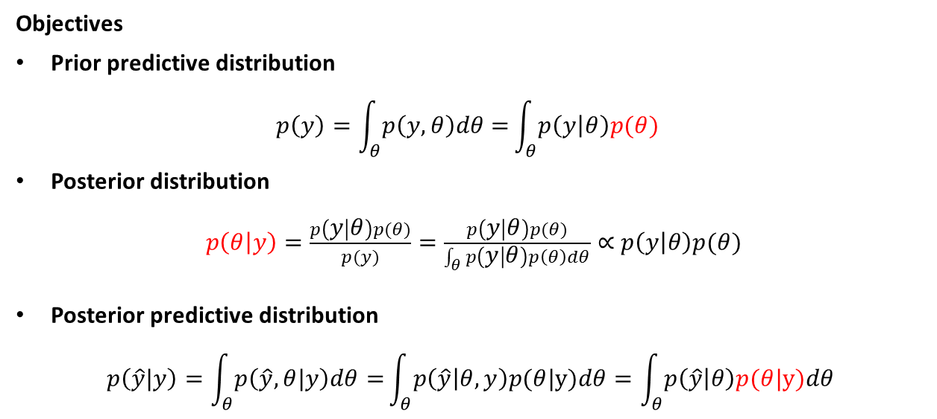











Bayesian Inference Problems
$$θ$$
$${ y}_{1}$$
$${ y}_{2}$$
$$⋯$$
$${ y}_{n}$$
$${ \hat{y}}_{1}$$
$$⋯$$
$${ \hat{y}}_{m}$$
$$y=\left(y_{1},…,y_{n}\right)$$
$$\hat{y}=\left({ \hat{y}}_{1},…,{ \hat{y}}_{m}\right)$$
Observed
Unobserved (future value)
Objectives
Prior predictive distribution
$$p\left(y\right)=\int_{θ}^{ }{p\left(y,θ\right)dθ=}\int_{θ}^{ }{p\left(y | θ\right)p(θ) }$$
Posterior distribution
$p\left(θ | y\right)=\frac{p\left(y | θ\right)p(θ)}{p(y)}=\frac{p\left(y | θ\right)p(θ)}{\int_{θ}^{ }{p\left(y | θ\right)p\left(θ\right)dθ}}∝$ $p\left(y | θ\right)p(θ)$
Posterior predictive distribution
$$p\left(\hat{y}|y\right)=\int_{θ}^{ }{p\left(\hat{y},θ|y\right)dθ=}\int_{θ}^{ }{p\left(\hat{y} | θ,y\right)p(θ|y)dθ}=\int_{θ}^{ }{p\left(\hat{y} | θ\right)p(θ|y)dθ}$$
$p\left(\hat{y} | θ,y\right)=p\left(\hat{y} | θ\right) because \hat{y}⊥$ $y$| $θ$

Slide 11
Binomial Likelihood and Beta Prior Distribution (Recap)

Slide 12

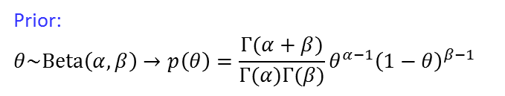

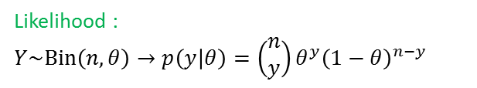
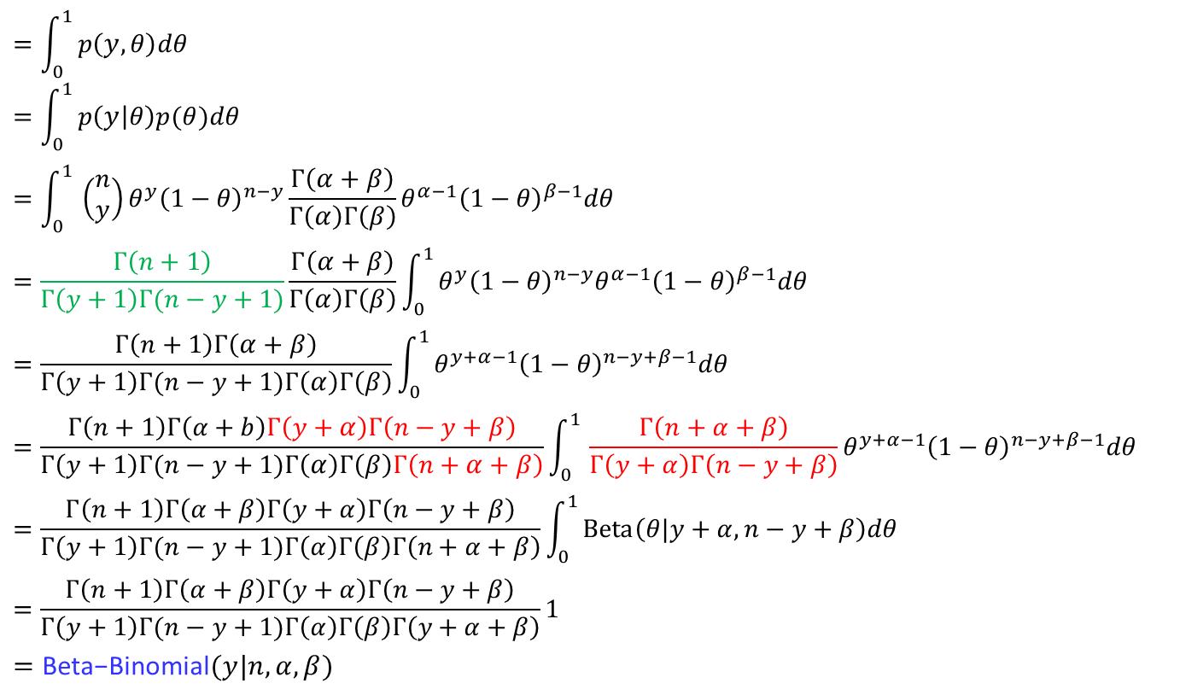

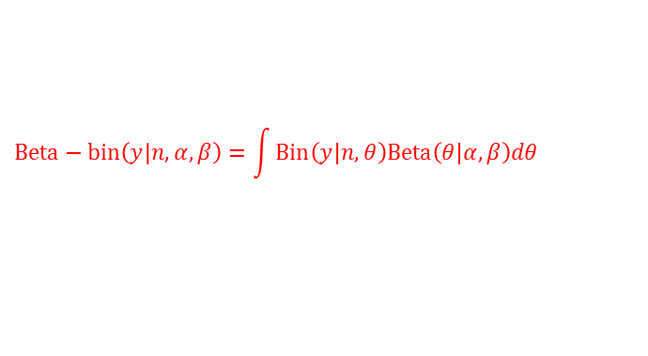
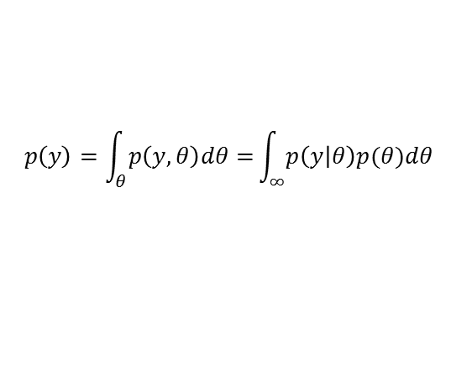

Binomial Likelihood and Beta Prior Distribution (Recap)
Likelihood :
$$Y\sim Bin\left(n,θ\right)→p\left(y | θ\right)=\left(\begin{aligned}n \\ y\end{aligned}\right)θ^{y}{\left(1−θ\right)}^{n−y}$$
Prior:
$$θ\sim Beta\left(α,β\right)→p\left(θ\right)=\frac{Γ(α+β)}{Γ(α)Γ(β)}θ^{α−1}{\left(1−θ\right)}^{β−1}$$
Prior predictive distribution :
$$p\left(y\right)=\int_{θ}^{ }{p\left(y,θ\right)dθ=}\int_{∞}^{ }{p\left(y | θ\right)p(θ)dθ}$$
$$=\int_{0}^{1 }{p\left(y,θ\right)dθ}$$
$$=\int_{0}^{1 }{p\left(y | θ\right)p(θ)dθ}$$
$$=\int_{0}^{1 }{\left(\begin{aligned}n \\ y\end{aligned}\right)θ^{y}{\left(1−θ\right)}^{n−y}\frac{Γ\left(α+β\right)}{Γ\left(α\right)Γ\left(β\right)}θ^{α−1}{\left(1−θ\right)}^{β−1}dθ}$$
$$=\frac{Γ\left(n+1\right)}{Γ\left(y+1\right)Γ(n−y+1)}\frac{Γ\left(α+β\right)}{Γ\left(α\right)Γ\left(β\right)}\int_{0}^{1 }{θ^{y}{\left(1−θ\right)}^{n−y}θ^{α−1}{\left(1−θ\right)}^{β−1}dθ}$$
$$=\frac{Γ\left(n+1\right)Γ\left(α+β\right)}{Γ\left(y+1\right)Γ(n−y+1)Γ\left(α\right)Γ\left(β\right)}\int_{0}^{1 }{θ^{y+α−1}{\left(1−θ\right)}^{n−y+β−1}dθ}$$
$$=\frac{Γ\left(n+1\right)Γ\left(α+b\right)Γ\left(y+α\right)Γ\left(n−y+β\right)}{Γ\left(y+1\right)Γ(n−y+1)Γ\left(α\right)Γ\left(β\right)Γ\left(n+α+β\right)}\int_{0}^{1 }{\frac{Γ\left(n+α+β\right)}{Γ\left(y+α\right)Γ\left(n−y+β\right)}θ^{y+α−1}{\left(1−θ\right)}^{n−y+β−1}dθ}$$
$$=\frac{Γ\left(n+1\right)Γ\left(α+β\right)Γ\left(y+α\right)Γ\left(n−y+β\right)}{Γ\left(y+1\right)Γ(n−y+1)Γ\left(α\right)Γ\left(β\right)Γ\left(n+α+β\right)}\int_{0}^{1 }{Beta\left(θ|y+α, n−y+β\right)dθ}$$
$$=\frac{Γ\left(n+1\right)Γ\left(α+β\right)Γ\left(y+α\right)Γ\left(n−y+β\right)}{Γ\left(y+1\right)Γ(n−y+1)Γ\left(α\right)Γ\left(β\right)Γ\left(y+α+β\right)}1$$
$$=\text{Beta}\text{−}\text{Binomial}(y|n,α,β)$$
$$p\left(y\right)$$
$P\left(y | θ\right)=Bin\left(y | n,θ\right)$,
$$p\left(θ\right)=Beta(α,β)$$
$$\left(\begin{aligned}n \\ y\end{aligned}\right)=\frac{n!}{y!\left(n−y\right)!}=\frac{Γ\left(n+1\right)}{Γ\left(y+1\right)Γ(n−y+1)}$$
The beta-binomial distribution is the binomial distribution in which the probability of success at each trial is not fixed but random and follows the beta distribution
$$Beta−bin\left(y | n,α, β\right)=\int{Bin\left(y|n,θ\right)Beta\left(θ|α,β\right)dθ}$$

Slide 13
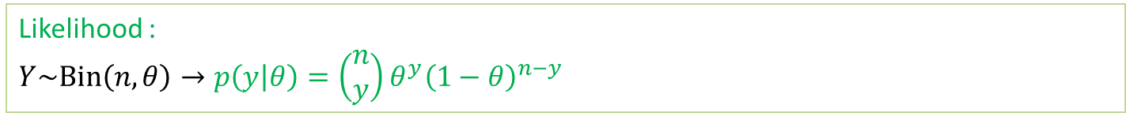

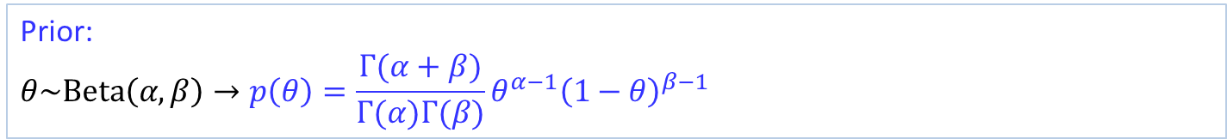

Binomial Likelihood and Beta Prior Distribution (Recap)
Likelihood :
$$Y\sim Bin\left(n,θ\right)→p\left(y | θ\right)=\left(\begin{aligned}n \\ y\end{aligned}\right)θ^{y}{\left(1−θ\right)}^{n−y}$$
$Y$ is the number of success among $n$ Bernoulli trial
Prior:
$$θ\sim Beta\left(α,β\right)→p\left(θ\right)=\frac{Γ(α+β)}{Γ(α)Γ(β)}θ^{α−1}{\left(1−θ\right)}^{β−1}$$
Posterior :
$$P(θ|y)$$
$$∝P\left(y | θ\right)p\left(θ\right)$$
$$=\left({n \atop y}\right)θ^{y}{\left(1−θ\right)}^{n−y}\frac{Γ(α+β)}{Γ(α)Γ(β)}θ^{α−1}{\left(1−θ\right)}^{β−1}$$
$$∝θ^{y}{\left(1−θ\right)}^{n−y}θ^{α−1}{\left(1−θ\right)}^{β−1}$$
$$=θ^{α+y−1}{\left(1−θ\right)}^{β+n−y−1}$$
$$=Beta\left(θ|α+y,β+n−y\right)$$
($α$ is pseudo counts for the success while $β$ is a pseudo counts for the failure)

Slide 14
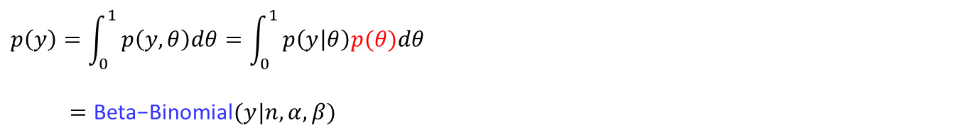
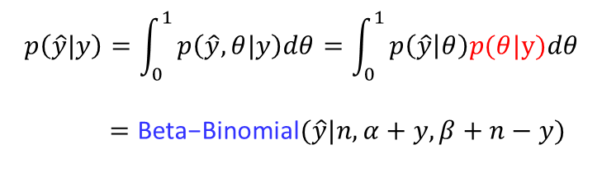



Binomial Likelihood and Beta Prior Distribution (Recap)
Likelihood :
$$Y\sim Bin\left(n,θ\right)→p\left(y | θ\right)=\left(\begin{aligned}n \\ y\end{aligned}\right)θ^{y}{\left(1−θ\right)}^{n−y}$$
$Y$ is the number of success among $n$ Bernoulli trial
Prior:
$$θ\sim Beta\left(α,β\right)→p\left(θ\right)=\frac{Γ(α+β)}{Γ(α)Γ(β)}θ^{α−1}{\left(1−θ\right)}^{β−1}$$
Posterior :
$$P(θ|y)=Beta\left(θ|α+y,β+n−y\right)$$
Posterior predictive distribution :
$$p\left(\hat{y}|y\right)=\int_{0}^{1 }{p\left(\hat{y},θ|y\right)dθ}=\int_{0}^{1 }{p\left(\hat{y} | θ\right)p(θ|y)dθ}$$
$$p\left(y\right)=\int_{0}^{1 }{p\left(y,θ\right)dθ}=\int_{0}^{1 }{p\left(y | θ\right)p(θ)dθ}$$
$=\text{Beta}\text{−}\text{Binomial}(y|n,α, β)$
$$p\left(θ\right)=Beta(α, β)$$
Using this result, the posterior predictive distribution is
$$p\left(\hat{y}|y\right)=\int_{0}^{1 }{p\left(\hat{y},θ|y\right)dθ}=\int_{0}^{1 }{p\left(\hat{y} | θ\right)p(θ|y)dθ}$$
$$=\text{Beta}\text{−}\text{Binomial}(\hat{y}|n,α+y, β+n−y)$$
$$p\left(θ | y\right)=Beta(α+y, β+n−y)$$

Slide 15
Poisson Likelihood-Gamma Prior

Slide 16

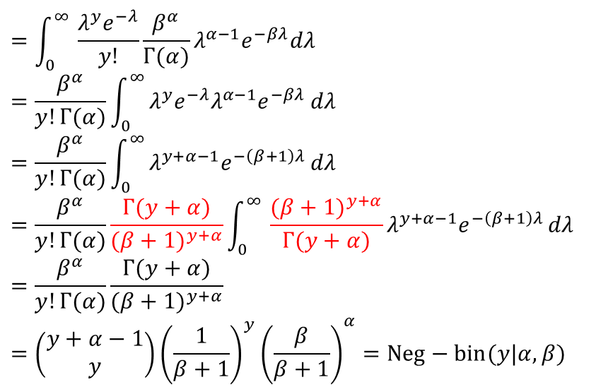

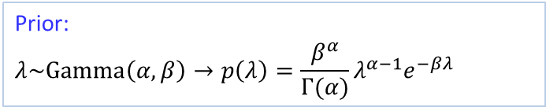

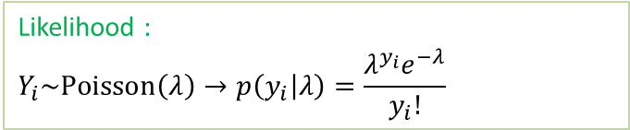
Poisson Likelihood-Gamma Prior
Likelihood :
$$Y_{i}\sim Poisson\left(λ\right)→p\left(y_{i} | λ\right)=\frac{λ^{y_{i}}e^{−λ}}{y_{i}!}$$
Prior:
$$λ\sim Gamma\left(α,β\right)→p\left(λ\right)=\frac{β^{α}}{Γ(α)}λ^{α−1}e^{−βλ}$$
Prior predictive distribution :
$$p\left(y\right)=\int_{θ}^{ }{p\left(y,λ\right)dθ=}\int_{θ}^{ }{p\left(y | λ\right)p(λ)dθ}$$
$$=\int_{0}^{∞ }{\frac{λ^{y}e^{−λ}}{y!}\frac{β^{α}}{Γ(α)}λ^{α−1}e^{−βλ}dλ}$$
$$=\frac{β^{α}}{y!Γ(α)}\int_{0}^{∞ }{λ^{y}e^{−λ}λ^{α−1}e^{−βλ}}dλ$$
$$=\frac{β^{α}}{y!Γ(α)}\int_{0}^{∞ }{λ^{y+α−1}e^{−\left(β+1\right)λ}}dλ$$
$$=\frac{β^{α}}{y!Γ(α)}\frac{Γ(y+α)}{({β+1)}^{y+α}}\int_{0}^{∞ }{\frac{({β+1)}^{y+α}}{Γ(y+α)}λ^{y+α−1}e^{−\left(β+1\right)λ}}dλ$$
$$=\frac{β^{α}}{y!Γ(α)}\frac{Γ(y+α)}{({β+1)}^{y+α}}$$
$$=\left(\begin{aligned}y+α−1 \\ y\end{aligned}\right){{\left(\frac{1}{β+1}\right)}^{y}\left(\frac{β}{β+1}\right)}^{α}=Neg−bin(y|α, β)$$
$$p\left(y\right)$$
$$Gamma\left(λ|α+y,β+1\right)$$
Negative Binomial distribution ($Neg−bin$) is a discrete probability distribution of the number of successes $y$in a sequence of independent and identically distributed Bernoulli trials before a specified (non-random) number of failures (denoted $α$) occurs.
$$Neg−bin\left(y | α, β\right)=\int{Poisson\left(y|λ\right)Gamma\left(λ|α,β\right)dλ}$$

Slide 17
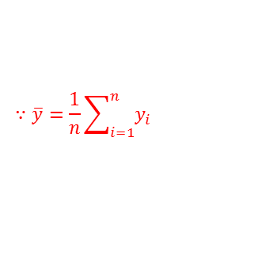
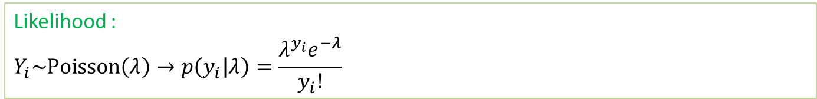



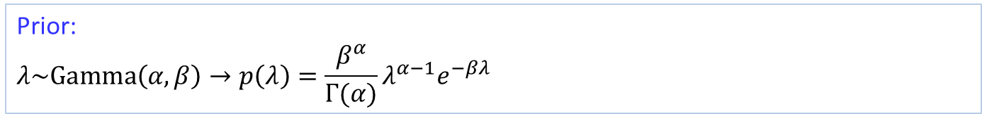



Poisson Likelihood-Gamma Prior
Likelihood :
$$Y_{i}\sim Poisson\left(λ\right)→p\left(y_{i} | λ\right)=\frac{λ^{y_{i}}e^{−λ}}{y_{i}!}$$
$$E\left(Y_{i}\right)=λ$$
Prior:
$$λ\sim Gamma\left(α,β\right)→p\left(λ\right)=\frac{β^{α}}{Γ(α)}λ^{α−1}e^{−βλ}$$
$$E\left(λ\right)=\frac{α}{β}$$
Posterior :
$$P(λ|y)$$
$y=(y_{1},…,y_{n})$ is a sequence of i.i.d. observation
$$∝P\left(y | λ\right)p\left(λ\right)$$
$$=\prod_{i=1}^{n}{P\left(y_{i} | λ\right)p\left(λ\right)}$$
$$=\prod_{i=1}^{n}{\frac{λ^{y_{i}}e^{−λ}}{y_{i}!}\frac{β^{α}}{Γ(α)}λ^{α−1}e^{−βλ}}$$
$$=\frac{λ^{{Σ_{i}y}_{i}}e^{−nλ}}{\prod_{i}^{n}{y_{i}!}}\frac{β^{α}}{Γ(α)}λ^{α−1}e^{−βλ}$$
$$∝λ^{n\overline{y}}e^{−nλ}λ^{α−1}e^{−βλ}$$
$$∝λ^{α+n\overline{y}−1}e^{−(β+n)λ}$$
$$=Gamma\left(α+n\overline{y},β+n\right)$$
$$∵\overline{y}=\frac{1}{n}\sum_{i=1}^{n}{y_{i}}$$
$$E\left(λ\right)=\frac{α+n\overline{y}}{β+n}=\frac{α+{Σ_{i}y}_{i}}{β+n}$$
($α$ is a pseudo count for #events while $β$ is a pseudo count for #observations)

Slide 18
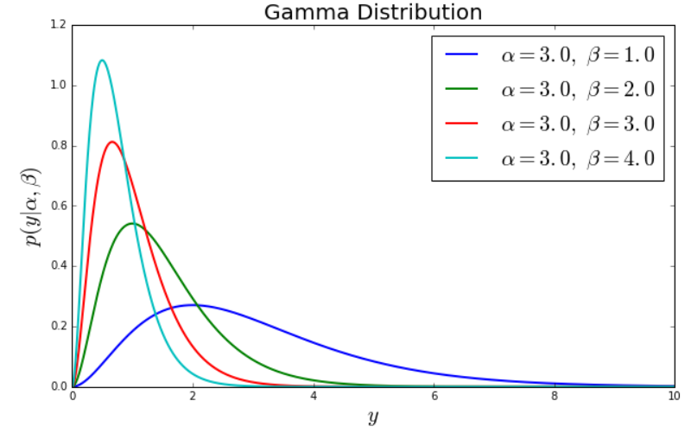

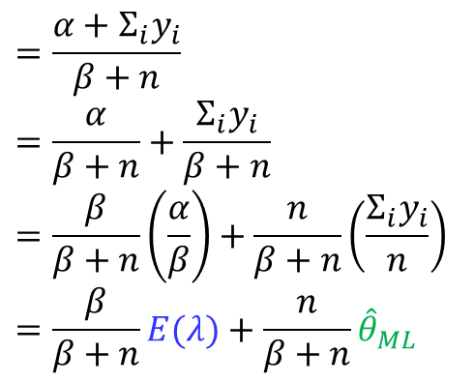

Poisson Likelihood-Gamma Prior
The posterior mean is
$$=\frac{α+{Σ_{i}y}_{i}}{β+n}$$
$$=\frac{α}{β+n}+\frac{{Σ_{i}y}_{i}}{β+n}$$
$$=\frac{β}{β+n}\left(\frac{α}{β}\right)+\frac{n}{β+n}\left(\frac{{Σ_{i}y}_{i}}{n}\right)$$
$$=\frac{β}{β+n}E(λ)+\frac{n}{β+n}{\hat{θ}}_{ML}$$
$$E\left(λ|y\right)$$
Again, the data get weighted more heavily as $n→∞$
$β$ control strength of prior

Slide 19
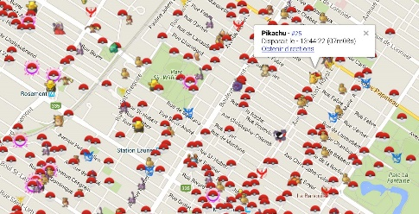
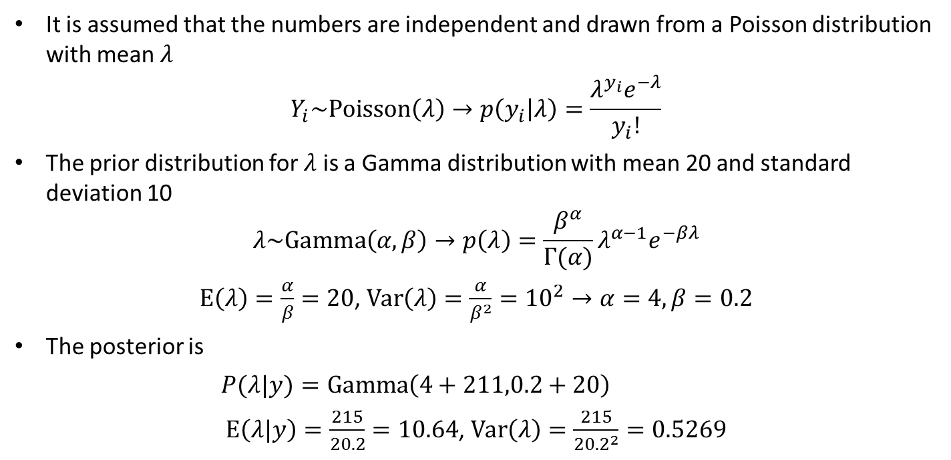

Example
Counts the numbers of PocketMons in each district of SF. The number are
14 13 7 10 15 15 2 13 13 11 10 13 5 13 9 12 9 12 8 7
It is assumed that the numbers are independent and drawn from a Poisson distribution with mean $λ$
$$Y_{i}\sim Poisson\left(λ\right)→p\left(y_{i} | λ\right)=\frac{λ^{y_{i}}e^{−λ}}{y_{i}!}$$
The prior distribution for $λ$ is a Gamma distribution with mean 20 and standard deviation 10
$$λ\sim Gamma\left(α,β\right)→p\left(λ\right)=\frac{β^{α}}{Γ(α)}λ^{α−1}e^{−βλ}$$
$E\left(λ\right)=\frac{α}{β}=20$, $Var\left(λ\right)=\frac{α}{β^{2}}={10}^{2}→α=4, β=0.2$
The posterior is
$P(λ|y)=Gamma\left(4+211,0.2+20\right)$
$E\left(λ|y\right)=\frac{215}{20.2}=10.64$, $Var\left(λ\right)=\frac{215}{{20.2}^{2}}=0.5269$
$$P(λ|y)=Gamma\left(α+n\overline{y},β+n\right)$$

Slide 20
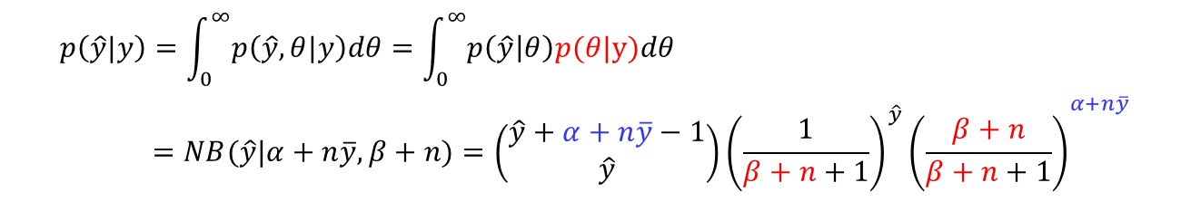




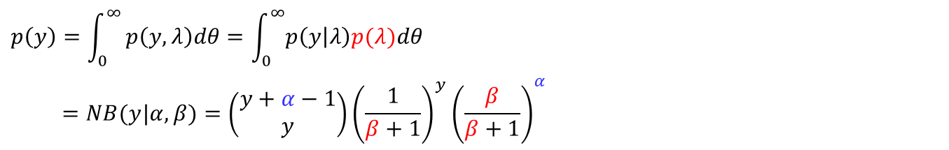
Poisson Likelihood-Gamma Prior
Likelihood :
$$Y_{i}\sim Poisson\left(λ\right)→p\left(y_{i} | λ\right)=\frac{λ^{y_{i}}e^{−λ}}{y_{i}!}$$
Prior:
$$λ\sim Gamma\left(α,β\right)→p\left(λ\right)=\frac{β^{α}}{Γ(α)}λ^{α−1}e^{−βλ}$$
Posterior :
$y=(y_{1},…,y_{n})$ is a sequence of i.i.d. observation
$$P(λ|y)=Gamma\left(α+n\overline{y},β+n\right)$$
Posterior predictive distribution (Using Bayes’ rule)
$$p\left(\hat{y}|y\right)=\int_{λ}^{ }{p\left(\hat{y},λ|y\right)dθ}=\int_{λ}^{ }{p\left(\hat{y} | λ\right)p(λ|y)dθ}$$
$$p\left(y\right)=\int_{0}^{∞ }{p\left(y,λ\right)dθ}=\int_{0}^{∞}{p\left(y | λ\right)p(λ)dθ}$$
$$=NB(y|α, β)={\left(\begin{aligned}y+α−1 \\ y\end{aligned}\right){\left(\frac{1}{β+1}\right)}^{y}\left(\frac{β}{β+1}\right)}^{α}$$
$$p\left(θ\right)=Gamma(α, β)$$
Using this result, the posterior predictive distribution is
$$p\left(\hat{y}|y\right)=\int_{0}^{∞}{p\left(\hat{y},θ|y\right)dθ}=\int_{0}^{∞}{p\left(\hat{y} | θ\right)p(θ|y)dθ}$$
$$=NB(\hat{y}|α+n\overline{y}, β+n)={\left(\begin{aligned}\hat{y}+α+n\overline{y}−1 \\ \hat{y}\end{aligned}\right){\left(\frac{1}{β+n+1}\right)}^{\hat{y}}\left(\frac{β+n}{β+n+1}\right)}^{α+n\overline{y}}$$
$$p\left(θ | y\right)=Gamma\left(α+n\overline{y},β+n\right)$$

Slide 21
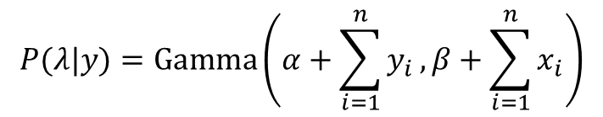
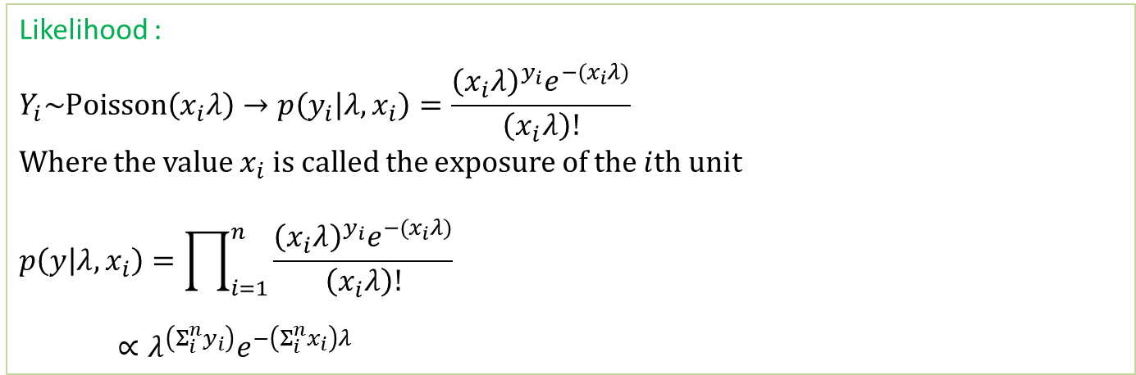
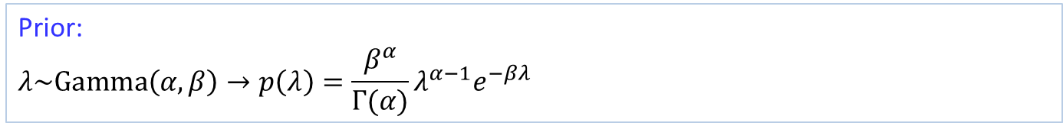
Poisson model parameterized in terms of rate and exposure
Likelihood :
$$Y_{i}\sim Poisson\left(x_{i}λ\right)→p\left(y_{i} | λ,x_{i}\right)=\frac{{\left(x_{i}λ\right)}^{y_{i}}e^{−(x_{i}λ)}}{\left(x_{i}λ\right)!}$$
Where the value $x_{i}$ is called the exposure of the $i$th unit
$$p\left(y | λ,x_{i}\right)=\prod_{i=1}^{n}{\frac{{\left(x_{i}λ\right)}^{y_{i}}e^{−(x_{i}λ)}}{\left(x_{i}λ\right)!}}$$
$∝λ^{\left(Σ_{i}^{n}y_{i}\right)}e^{−\left(Σ_{i}^{n}x_{i}\right)λ}$
$y=(y_{1},…,y_{n})$ is a sequence of i.i.d. observation
It is more flexible model in that we can control the unit time or area
Prior:
$$λ\sim Gamma\left(α,β\right)→p\left(λ\right)=\frac{β^{α}}{Γ(α)}λ^{α−1}e^{−βλ}$$
Posterior :
$$P(λ|y)=Gamma\left(α+\sum_{i=1}^{n}{y_{i}}, β+\sum_{i=1}^{n}{x_{i}}\right)$$

Slide 22
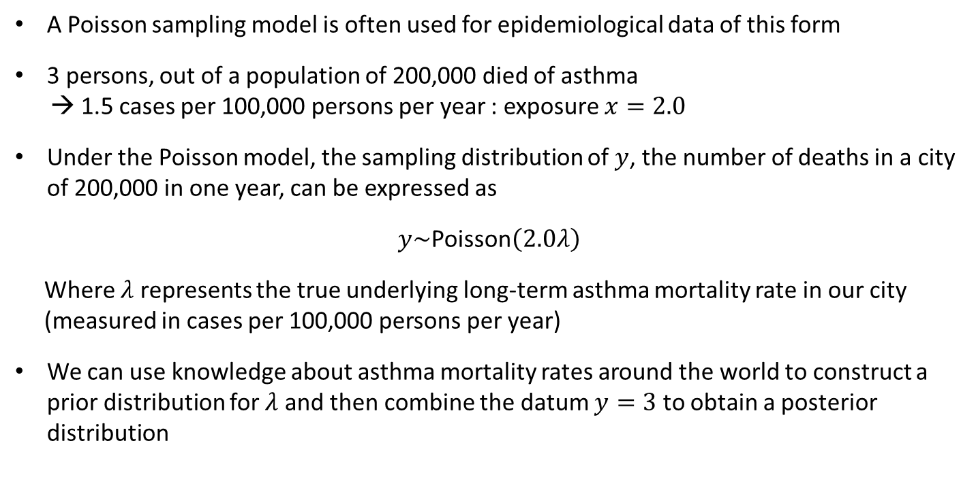
Estimating a rate from Poisson data: an idealized example
A Poisson sampling model is often used for epidemiological data of this form
3 persons, out of a population of 200,000 died of asthma
→ 1.5 cases per 100,000 persons per year : exposure $x=2.0$
Under the Poisson model, the sampling distribution of $y$, the number of deaths in a city of 200,000 in one year, can be expressed as
$y\sim$Poisson$\left(2.0λ\right)$
Where $λ$ represents the true underlying long-term asthma mortality rate in our city
(measured in cases per 100,000 persons per year)
We can use knowledge about asthma mortality rates around the world to construct a prior distribution for $λ$ and then combine the datum $y=3$ to obtain a posterior distribution

Slide 23
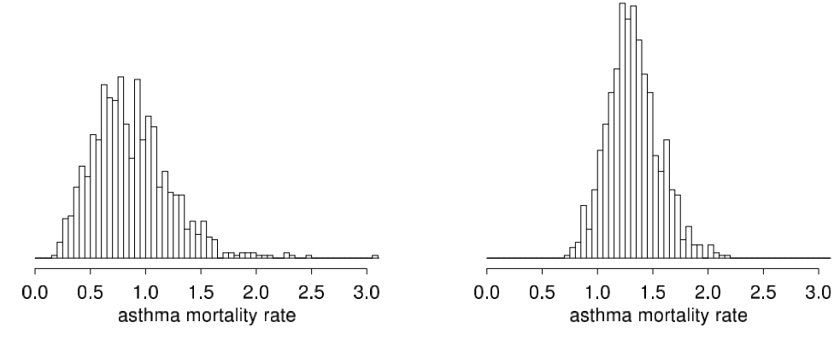
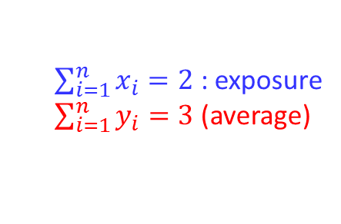

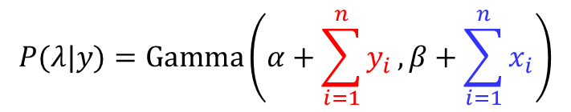
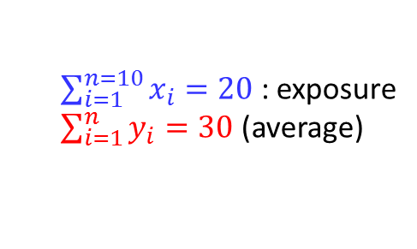


Estimating a rate from Poisson data: an idealized example
Prior:
$$λ\sim Gamma\left(α=3,β=5\right)$$
$$λ=\#death per 1\text{00,000}$$
Posterior :
$$P(λ|y)=Gamma\left(α+\sum_{i=1}^{n}{y_{i}}, β+\sum_{i=1}^{n}{x_{i}}\right)$$
Case 1: 3 persons, out of a population
of 200,000 died of asthma for years
Case 1: 30 persons, out of a population
of 200,000 died of asthma for 10 years
$\sum_{i=1}^{n}{x_{i}}=2$ : exposure
$\sum_{i=1}^{n}{y_{i}}=3$ (average)
$\sum_{i=1}^{n=10}{x_{i}}=20$ : exposure
$\sum_{i=1}^{n}{y_{i}}=30$ (average)
$$P(λ|y)=Gamma\left(3+3, 5+2\right)$$
$$P(λ|y)=Gamma\left(3+30, 5+20\right)$$

Slide 24
Estimating a rate from Poisson data: an idealized example
Jupyter Demo Simulation

Slide 25
Exponential Likelihood-Gamma Prior

Slide 26





Exponential Likelihood-Gamma Prior
Likelihood :
$$Y_{i}\sim Exp\left(λ\right)→p\left(y_{i} | λ\right)=λe^{−λy_{i}}$$
$$E\left(Y_{i}\right)=\frac{1}{λ}$$
Prior:
$$λ\sim Gamma\left(α,β\right)→p\left(λ\right)=\frac{β^{α}}{Γ(α)}λ^{α−1}e^{−βλ}$$
Posterior :
$$P(λ|y)$$
$y=(y_{1},…,y_{n})$ is a sequence of i.i.d. observation
$$∝P\left(y | λ\right)p\left(λ\right)$$
$$=\prod_{i=1}^{n}{P\left(y_{i} | λ\right)p\left(λ\right)}$$
$$=\prod_{i=1}^{n}{λe^{−λy_{i}}\frac{β^{α}}{Γ(α)}λ^{α−1}e^{−βλ}}$$
$$=λ^{n}e^{−λΣ_{i}y_{i}}\frac{β^{α}}{Γ(α)}λ^{α−1}e^{−βλ}$$
$$∝λ^{n}e^{−λn\overline{y}}λ^{α−1}e^{−βλ}$$
$$=λ^{α+n−1}e^{−(β+n\overline{y})λ}$$
$$=Gamma\left(α+n,β+n\overline{y}\right)$$
$$∵\overline{y}=\frac{1}{n}\sum_{i=1}^{n}{y_{i}}$$

Slide 27
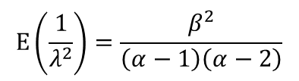
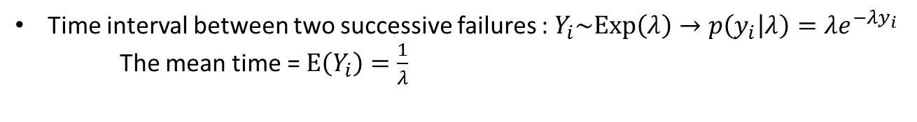
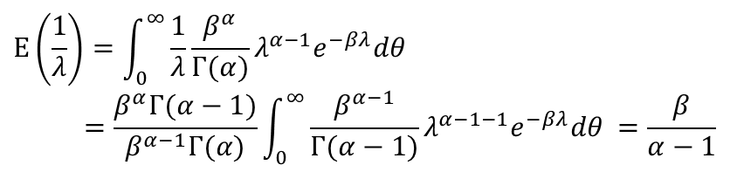

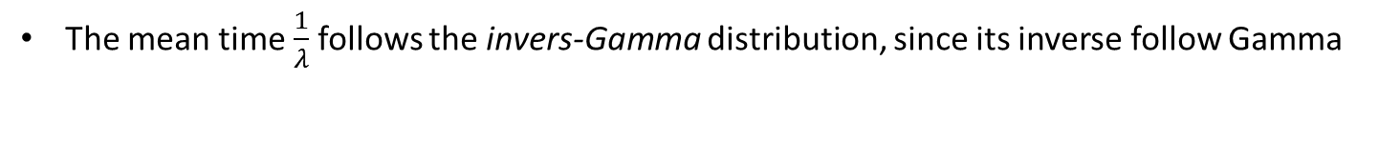


Exponential Likelihood-Gamma Prior (Example)
A machine continuously produces nylon filament. From time to time the filament snaps. Suppose that the time intervals, in minutes, between snaps are random, independent and have an exponential distribution.
Time interval between two successive failures : $Y_{i}\sim Exp\left(λ\right)→p\left(y_{i} | λ\right)=λe^{−λy_{i}}$
The mean time = $E\left(Y_{i}\right)=\frac{1}{λ}$
Piror $λ\sim Gamma\left(α=6,β=1800\right)$
$E\left(λ\right)=\frac{6}{1800}=0.0033, Var\left(λ\right)=\frac{6}{{1800}^{2}}=1.85 ×{10}^{−6}$
The mean time $\frac{1}{λ}$ follows the invers-Gamma distribution, since its inverse follow Gamma
$$E\left(\frac{1}{λ}\right)=\int_{0}^{∞}{\frac{1}{λ}\frac{β^{α}}{Γ(α)}λ^{α−1}e^{−βλ}dθ }$$
$$=\frac{β^{α}Γ(α−1)}{β^{α−1}Γ(α)}\int_{0}^{∞}{\frac{β^{α−1}}{Γ(α−1)}λ^{α−1−1}e^{−βλ}dθ }=\frac{β}{α−1}$$
$$λ\sim Gamma\left(α,β\right)→p\left(λ\right)=\frac{β^{α}}{Γ(α)}λ^{α−1}e^{−βλ}$$
$$E\left(\frac{1}{λ^{2}}\right)=\frac{β^{2}}{\left(α−1\right)\left(α−2\right)}$$
$$Var\left(\frac{1}{λ}\right)=\frac{β^{2}}{\left(α−1\right)\left(α−2\right)}−{\left(\frac{β}{α−1} \right)}^{2}=\frac{β^{2}}{{\left(α−1\right)}^{2}\left(α−2\right)}$$

Slide 28


Exponential Likelihood-Gamma Prior (Example)
$$Y_{i}\sim Exp\left(λ\right)→p\left(y_{i} | λ\right)=λe^{−λy_{i}}$$
$$λ\sim Gamma\left(α=6,β=1800\right)$$
The prior mean for the time interval : $E\left(\frac{1}{λ}\right)=\frac{β}{α−1}=\frac{1800}{6−1}=360(5 \text{hours}\text{)}$
The prior variance for the time interval : $var\left(\frac{1}{λ}\right)=\frac{β^{2}}{{\left(α−1\right)}^{2}\left(α−2\right)}=\frac{{1800}^{2}}{5^{2}×4}=32,400$
The prior std. for the time interval : $std\left(\frac{1}{λ}\right)=\sqrt{32,400}=180(\text{3}\text{hours}\text{)}$
Observations:
55 30 231 592 141 139 695 56 803 642 1890 208 246 183 38 486 264 1091 368 222 662 150 2 133 417 418 743 216 138 306 201 145 804 193 66 577 773 268 388 861
$$P\left(λ | y\right)=Gamma\left(α+n,β+Σ_{i}y_{i}\right)=Gamma\left(6+40,1,800+15,841\right)$$
The posterior mean for the time interval : $E\left(\frac{1}{λ}|y\right)=\frac{β}{α−1}=\frac{1800+15,841}{46−1}=392.0(\text{minutes}\text{)}$
The posterior variance for the time interval : $var\left(\frac{1}{λ}|y\right)=\frac{β^{2}}{{\left(α−1\right)}^{2}\left(α−2\right)}=\frac{{17641}^{2}}{45^{2}×44}=3492.76$
The posterior std. for the time interval : $std\left(\frac{1}{λ}|y\right)=\sqrt{3492.76}=59.1(\sim \text{1}\text{hours}\text{)}$

Slide 29
Normal Likelihood-Normal Prior (unknown mean and known variance)

Slide 30









Normal Likelihood-Normal Prior (unknown mean and known variance)
Likelihood :
$$Y_{i}\sim N\left(θ, σ_{Y}^{2}\right)→p\left(y_{i} | θ,σ_{Y}^{2}\right)=\frac{1}{\sqrt{2πσ_{Y}^{2}}}\exp\left(−\frac{{\left(y_{i}−θ\right)}^{2}}{2σ_{Y}^{2}}\right)$$
Note that $θ=μ_{Y}, (σ_{Y}^{2}$is known)
Prior:
$$θ\sim N\left(μ_{0}, τ_{0}^{2}\right)→p\left(θ\right)=\frac{1}{\sqrt{2πτ_{o}^{2}}}\exp\left(−\frac{{\left(θ−μ_{0}\right)}^{2}}{2τ_{o}^{2}}\right)$$
Prior predictive distribution :
Before the data $y$ are considered, the distribution of the unknown but observable $y$ is
$$p\left(y\right)=\int_{θ}^{ }{p\left(y,θ\right)dθ=}\int_{−∞}^{∞ }{p\left(y | θ\right)p(θ)dθ}$$
(Without integration)
$$E\left(y\right)=E\left[E\left(y|θ\right)\right]=E\left[θ\right]=μ_{0}$$
$$∵E\left(y|θ\right)=θ$$
$$var\left(y\right)=E\left[var\left(y|θ\right)\right]+var\left(E\left(y|θ\right)\right)$$
$$=E\left(σ_{Y}^{2}\right)+var\left(θ\right)$$
$$=σ_{Y}^{2}+τ_{0}^{2}$$
$$∵var\left(y|θ\right)=σ_{Y}^{2}$$
$$p\left(y\right)=N\left(y|μ_{0}, σ_{Y}^{2}+τ_{0}^{2}\right)$$

Slide 31





Normal Likelihood-Normal Prior (unknown mean and known variance)
Likelihood :
$$Y_{i}\sim N\left(θ, σ_{Y}^{2}\right)→p\left(y_{i} | θ,σ_{Y}^{2}\right)=\frac{1}{\sqrt{2πσ_{Y}^{2}}}\exp\left(−\frac{{\left(y_{i}−θ\right)}^{2}}{2σ_{Y}^{2}}\right)$$
Note that $θ=μ_{Y}, (σ_{Y}^{2}$is known)
Prior:
$$θ\sim N\left(μ_{0}, τ_{0}^{2}\right)→p\left(θ\right)=\frac{1}{\sqrt{2πτ_{o}^{2}}}\exp\left(−\frac{{\left(θ−μ_{0}\right)}^{2}}{2τ_{o}^{2}}\right)$$
Posterior :
$$P(θ|y)$$
$$∝P\left(y | θ,σ_{Y}^{2}\right)p\left(θ\right)$$
$$=\prod_{i=1}^{n}{\frac{1}{\sqrt{2πσ^{2}}}\exp\left(−\frac{{\left(y_{i}−θ\right)}^{2}}{2σ_{Y}^{2}}\right)×}\frac{1}{\sqrt{2πτ_{o}^{2}}}\exp\left(−\frac{{\left(θ−μ_{0}\right)}^{2}}{2τ_{o}^{2}}\right)$$
$$∝\exp\left(−\sum_{i=1}^{n}{\frac{{\left(y_{i}−θ\right)}^{2}}{2σ_{Y}^{2}}}+\frac{{\left(θ−μ_{0}\right)}^{2}}{{2τ}_{0}^{2}}\right)$$
$$=\exp\left[−\frac{1}{2}\left(\sum_{i=1}^{n}{\frac{{\left(y_{i}−θ\right)}^{2}}{σ_{Y}^{2}}}+\frac{{\left(θ−μ_{0}\right)}^{2}}{τ_{0}^{2}}\right)\right]$$
$$=\exp\left[−\frac{1}{2σ_{Y}^{2}τ_{0}^{2}}\left(τ_{0}^{2}\sum_{i=1}^{n}{{\left(y_{i}−θ\right)}^{2}}+{σ_{Y}^{2}\left(θ−μ_{0}\right)}^{2}\right)\right]$$
$$=\exp\left[−\frac{1}{2σ_{Y}^{2}τ_{0}^{2}}\left(τ_{0}^{2}\sum_{i=1}^{n}{{\left(y_{i}^{2}−2θy_{i}+θ^{2}\right)}^{ }}+{σ_{Y}^{2}\left(θ^{2}−2θμ_{0}+μ_{0}^{2}\right)}^{ }\right)\right]$$
$y=(y_{1},…,y_{n})$ is a sequence of i.i.d. observation

Slide 32



Normal Likelihood-Normal Prior (unknown mean and known variance)
Posterior :
$$∝\exp\left[−\frac{1}{2σ_{Y}^{2}τ_{0}^{2}}\left(τ_{0}^{2}\sum_{i=1}^{n}{{\left(y_{i}^{2}−2θy_{i}+θ^{2}\right)}^{ }}+{σ_{Y}^{2}\left(θ^{2}−2θμ_{0}+μ_{0}^{2}\right)}^{ }\right)\right]$$
$$=\exp\left[−\frac{1}{2σ_{Y}^{2}τ_{0}^{2}}\left(τ_{0}^{2}\sum_{i=1}^{n}{{y_{i}^{2}−2τ_{0}^{2}θn\overline{y}+{τ_{0}^{2}nθ}^{2}}^{ }}+{σ_{Y}^{2}θ^{2}−2σ_{Y}^{2}θμ_{0}+{σ_{Y}^{2}μ}_{0}^{2}}^{ }\right)\right]$$
$$=\exp\left[−\frac{1}{2σ_{Y}^{2}τ_{0}^{2}}\left(τ_{0}^{2}\sum_{i=1}^{n}{{y_{i}^{2}−2τ_{0}^{2}θn\overline{y}+{τ_{0}^{2}nθ}^{2}}^{ }}+{σ_{Y}^{2}θ^{2}−2σ_{Y}^{2}θμ_{0}+{σ_{Y}^{2}μ}_{0}^{2}}^{ }\right)\right]$$
$$∝\exp\left[−\frac{1}{2σ_{Y}^{2}τ_{0}^{2}}\left(θ^{2}\left(σ_{Y}^{2}+nτ_{0}^{2}\right)−2θ\left(μ_{0}σ_{Y}^{2}+n\overline{y}τ_{0}^{2}\right)+const\right)\right]$$
$$=exp\left[−\frac{1}{2}\left(θ^{2}\left(\frac{σ_{Y}^{2}+nτ_{0}^{2}}{σ_{Y}^{2}τ_{0}^{2}}\right)−2θ\left(\frac{μ_{0}σ_{Y}^{2}+n\overline{y}τ_{0}^{2}}{σ^{2}τ_{0}^{2}}\right)+const′\right)\right]$$
$$=exp\left[−\frac{1}{2}\left(θ^{2}\left(\frac{1}{τ_{0}^{2}}+\frac{n}{σ_{Y}^{2}}\right)−2θ\left(\frac{μ_{0}}{τ_{0}^{2}}+\frac{n\overline{y}}{σ_{Y}^{2}}\right)+const′\right)\right]$$
$$=exp\left[−\frac{1}{2}\left(\frac{1}{τ_{0}^{2}}+\frac{n}{σ_{Y}^{2}}\right)\left(θ^{2}−2θ\left(\frac{\frac{μ_{0}}{τ_{0}^{2}}+\frac{n\overline{y}}{σ_{Y}^{2}}}{\frac{1}{τ_{0}^{2}}+\frac{n}{σ_{Y}^{2}}}\right)+{const}^{′}\right)\right]$$
$$=exp\left[−\frac{1}{2}\left(\frac{1}{τ_{0}^{2}}+\frac{n}{σ_{Y}^{2}}\right){\left(θ−\left(\frac{\frac{μ_{0}}{τ_{0}^{2}}+\frac{n\overline{y}}{σ_{Y}^{2}}}{\frac{1}{τ_{0}^{2}}+\frac{n}{σ_{Y}^{2}}}\right)\right)}^{2}\right]$$
$$P(θ|y)$$
$$\left(∵\overline{y}=\frac{1}{n}\sum_{i=1}^{n}{{y_{i}^{ }}^{ }}\right)$$

Slide 33














Normal Likelihood-Normal Prior (unknown mean and known variance)
Likelihood :
$$Y_{i}\sim N\left(θ, σ_{Y}^{2}\right)→p\left(y_{i} | θ,σ_{Y}^{2}\right)=\frac{1}{\sqrt{2πσ_{Y}^{2}}}\exp\left(−\frac{{\left(y_{i}−θ\right)}^{2}}{2σ_{Y}^{2}}\right)$$
Prior:
$$θ\sim N\left(μ_{0}, τ_{0}^{2}\right)→p\left(θ\right)=\frac{1}{\sqrt{2πτ_{o}^{2}}}\exp\left(−\frac{{\left(θ−μ_{0}\right)}^{2}}{2τ_{o}^{2}}\right)$$
Posterior on $θ=μ_{Y}$
$$=N\left(θ | \frac{\frac{μ_{0}}{τ_{0}^{2}}+\frac{n\overline{y}}{σ_{Y}^{2}}}{\frac{1}{τ_{0}^{2}}+\frac{n}{σ_{Y}^{2}}},{\left(\frac{1}{τ_{0}^{2}}+\frac{n}{σ_{Y}^{2}}\right)}^{−1}\right)$$
$$P(θ|y)$$
Posterior mean $μ_{1}$ :
$$μ_{1}=\frac{\frac{μ_{0}}{τ_{0}^{2}}+\frac{n\overline{y}}{σ_{Y}^{2}}}{\frac{1}{τ_{0}^{2}}+\frac{n}{σ_{Y}^{2}}}=\frac{σ_{Y}^{2}μ_{0}}{σ_{Y}^{2}+nτ_{0}^{2}}+\frac{nτ_{0}^{2}\overline{y}}{σ^{2}+nτ_{0}^{2}}$$
$μ_{0}$: Prior mean
$\overline{y}=\frac{1}{n}\sum_{i=1}^{n}{{y_{i}^{ }}^{ }}$: Data mean
$τ_{0}^{2}↓⇒$Prior mean $μ_{0}$ becomes accurate and influence more to $μ_{1}$
$σ_{Y}^{2}↓⇒$ the data become precise, making $\overline{y}$ stronger
$n↑⇒\overline{y}$ stronger
Posterior variance $τ_{1}^{2}$ :
Posterior precision :
$$τ_{1}^{2}={\left(\frac{1}{τ_{0}^{2}}+\frac{n}{σ_{Y}^{2}}\right)}^{−1}$$
$$\frac{1}{τ_{1}^{2}}=\frac{1}{τ_{0}^{2}}+\frac{n}{σ_{Y}^{2}}$$
$\frac{1}{τ_{0}^{2}}$: Prior precision
$\frac{n}{σ^{2}}$: data precision

Slide 34











Normal Likelihood-Normal Prior (unknown mean and known variance)
Likelihood :
$$Y_{i}\sim N\left(θ, σ_{Y}^{2}\right)→p\left(y_{i} | θ,σ_{Y}^{2}\right)=\frac{1}{\sqrt{2πσ_{Y}^{2}}}\exp\left(−\frac{{\left(y_{i}−θ\right)}^{2}}{2σ_{Y}^{2}}\right)$$
Note that $θ=μ_{Y}, (σ_{Y}^{2}$is known)
Posterior :
$$θ=μ_{Y}$$
$$μ_{1}=\frac{\frac{μ_{0}}{τ_{0}^{2}}+\frac{n\overline{y}}{σ_{Y}^{2}}}{\frac{1}{τ_{0}^{2}}+\frac{n}{σ_{Y}^{2}}}$$
$$τ_{1}^{2}={\left(\frac{1}{τ_{0}^{2}}+\frac{n}{σ_{Y}^{2}}\right)}^{−1}$$
$$P(θ|y)=N\left(θ | μ_{1},τ_{1}^{2}\right)$$
$$E\left[θ|y\right]=μ_{1}$$
$$var\left(θ|y\right)=τ_{1}^{2}$$
Posterior predictive distribution
$$p\left(\hat{y}|y\right)=\int_{θ}^{ }{p\left(\hat{y},θ|y\right)dθ=}\int_{θ}^{ }{p\left(\hat{y} | θ,y\right)p(θ|y)dθ}=\int_{θ}^{ }{p\left(\hat{y} | θ\right)p(θ|y)dθ}$$
(Without integration)
$$E\left(\hat{y}|y\right)=E\left[E\left(\hat{y}|θ,y\right)|y\right]=E\left[θ|y\right]=μ_{1}$$
$$∵E\left(\hat{y}|θ,y\right)=E\left(\tilde{y}|θ\right)=θ$$
$$var\left(\hat{y}|y\right)=E\left[var\left(\hat{y}|θ,y\right)|y\right]+var\left(E\left(\hat{y}|θ,y\right)|y\right)$$
$$=E\left(σ_{Y}^{2}|y\right)+var\left(θ|y\right)$$
$$=σ_{Y}^{2}+τ_{1}^{2}$$
$$∵var\left(\hat{y}|θ,y\right)=σ_{Y}^{2}$$
$$p\left(\hat{y}|y\right)=N\left(\hat{y}|μ_{1}, σ_{Y}^{2}+τ_{1}^{2}\right)$$

Slide 35










Normal Likelihood-Normal Prior (unknown mean and known variance)
$$E\left(y\right)=E\left[E\left(y|θ\right)\right]=E\left[θ\right]=μ_{0}$$
$$∵E\left(y|θ\right)=θ$$
$$var\left(y\right)=E\left[var\left(y|θ\right)\right]+var\left(E\left(y|θ\right)\right)$$
$$=E\left(σ_{Y}^{2}\right)+var\left(θ\right)$$
$$=σ_{Y}^{2}+τ_{0}^{2}$$
$$∵var\left(y|θ\right)=σ_{Y}^{2}$$
$$p\left(y\right)=N\left(y|μ_{0}, σ_{Y}^{2}+τ_{0}^{2}\right)$$
$$E\left(\hat{y}|y\right)=E\left[E\left(\hat{y}|θ,y\right)|y\right]=E\left[θ|y\right]=μ_{1}$$
$$∵E\left(\hat{y}|θ,y\right)=E\left(\tilde{y}|θ\right)=θ$$
$$var\left(\hat{y}|y\right)=E\left[var\left(\hat{y}|θ,y\right)|y\right]+var\left(E\left(\hat{y}|θ,y\right)|y\right)$$
$$=E\left(σ_{Y}^{2}|y\right)+var\left(θ|y\right)$$
$$=σ_{Y}^{2}+τ_{1}^{2}$$
$$∵var\left(\hat{y}|θ,y\right)=σ_{Y}^{2}$$
$$p\left(\hat{y}|y\right)=N\left(\hat{y}|μ_{1}, σ_{Y}^{2}+τ_{1}^{2}\right)$$

Slide 36
Normal Likelihood-Normal Prior (unknown mean and known variance) : Example
Jupyter Demo Simulation

Slide 37
Normal Likelihood-Normal Prior (known mean and unknown variance)

Slide 38





Normal Likelihood-Normal Prior (known mean and unknown variance)
Likelihood :
$$Y_{i}\sim N\left(μ, θ\right)→p\left(y_{i} | μ, θ\right)=\frac{1}{\sqrt{2πθ}}\exp\left(−\frac{{\left(y_{i}−μ\right)}^{2}}{2θ}\right)$$
Note that $θ=σ^{2}, (μ$ is known)
Prior:
$$θ\sim Inv−Gamma\left(θ|α_{0},β_{0}\right)→p\left(θ\right)=\frac{β_{0}^{α_{0}}}{Γ(α_{0})}θ^{−(α_{0}+1)}\exp\left(−\frac{β_{0}}{θ}\right)$$
Posterior :
$$P(θ|y)$$
$$∝ p\left(y | θ\right)p\left(θ\right)$$
$$=\prod_{i=1}^{n}{\frac{1}{\sqrt{2πθ}}\exp\left(−\frac{{\left(y_{i}−μ\right)}^{2}}{2θ}\right)×}\frac{β_{0}^{α_{0}}}{Γ(α_{0})}θ^{−(α_{0}+1)}\exp\left(−\frac{β_{0}}{θ}\right)$$
$$∝\prod_{i=1}^{n}{θ^{−\frac{1}{2}}\exp\left(−\frac{{\left(y_{i}−μ\right)}^{2}}{2θ}\right)×}θ^{−(α_{0}+1)}\exp\left(−\frac{β_{0}}{θ}\right)$$
$$=θ^{−\left(α_{0}+1+\frac{n}{2}\right)}\exp\left(−\left(\frac{β_{0}}{θ}+\frac{\sum_{i=1}^{n}{{\left(y_{i}−μ\right)}^{2}}}{2θ}\right)\right)$$
$$=θ^{−\left(α_{0}+\frac{n}{2}+1\right)}\exp\left(−\left(\frac{β_{0}+\frac{1}{2}\sum_{i=1}^{n}{{\left(y_{i}−μ\right)}^{2}}}{θ}\right)\right)$$
$$=Inv−Gamma\left(θ | α_{0}+\frac{n}{2},β_{0}+\frac{1}{2}\sum_{i=1}^{n}{{\left(y_{i}−μ\right)}^{2}}\right)$$
$y=(y_{1},…,y_{i})$ is a sequence of i.i.d. observation

Slide 39
Normal Likelihood-Normal Prior (known mean and unknown variance) : Example
Population mean test score : normal
Jupyter Demo Simulation

Slide 40
Multi-Parameters Model

Slide 41







Multinomial Likelihood-Dirichlet Prior (unknown mean and known variance)
Likelihood :
$$p\left(y|θ\right)=Multin\left(y|n,θ_{1},…,θ_{k}\right)=\left({n \atop y_{1}{ y}_{2}⋯y_{k}}\right){θ_{1}}^{y_{1}}{⋯θ_{k}}^{y_{k}}$$
$${y=(y}_{1},…,{ y}_{j}, …,y_{k})$$
$$y_{j}∈\left\{0,1,…,n\right\}, \sum_{j=1}^{k}{y_{j}}=n$$
$$=\frac{Γ(n+1)}{\prod_{j=1}^{K}{Γ(x_{j}+1)}}\prod_{i=j}^{K}{θ_{j}^{y_{j}}}$$
Prior:
$$θ\sim Drichlet\left(α_{1},…,α_{k}\right)→p\left(θ\right)=\frac{Γ(α_{1}+…+α_{k})}{Γ(α_{1})⋯Γ(α_{k})}θ_{1}^{α_{1}−1}⋯θ_{k}^{α_{k}−1}$$
$$=\frac{Γ(\sum_{j=1}^{K}{α_{j}})}{\prod_{j=1}^{K}{Γ(α_{k})}}θ_{1}^{α_{1}−1}⋯θ_{k}^{α_{k}−1}$$
$$\sum_{j=1}^{k}{θ_{j}}=1$$
Posterior :
$$P(θ|y)$$
$$∝P\left(y | θ \right)p\left(θ\right)$$
$$=\frac{Γ(n+1)}{\prod_{j=1}^{K}{Γ(x_{j}+1)}}\prod_{j=1}^{K}{θ_{j}^{y_{j}}}\frac{Γ(\sum_{j=1}^{K}{α_{j}})}{\prod_{j=1}^{K}{Γ(α_{j})}}θ_{1}^{α_{1}−1}⋯θ_{k}^{α_{k}−1}$$
$$∝\prod_{j=1}^{K}{θ_{j}^{y_{j}}}\prod_{j=1}^{K}{θ_{j}^{a_{j}−1}}$$
$$∝\prod_{j=1}^{K}{θ_{j}^{a_{j}+y_{j}−1}}$$
$$=Drichlet\left(α_{1}+y_{1},…,α_{k}+y_{k}\right)$$

Slide 42


Multinomial Likelihood-Dirichlet Prior (unknown mean and known variance)
Posterior predictive distribution
$$p\left(\hat{y}|y\right)=\int_{θ}^{ }{p\left(\hat{y},θ|y\right)dθ=}\int_{θ}^{ }{p\left(\hat{y} | θ,y\right)p(θ|y)dθ}=\int_{θ}^{ }{p\left(\hat{y} | θ\right)p(θ|y)dθ}$$
$$p\left(\hat{y}|y\right)$$
$$=\int_{θ}^{ }{p\left(\hat{y} | θ_{1},…,θ_{k}\right)p(θ_{1},…,θ_{k}|y)dθ}$$
$$=\int_{θ}^{ }{\frac{Γ(n+1)}{\prod_{j=1}^{K}{Γ(y_{j}+1)}}\prod_{j=1}^{K}{θ_{j}^{y_{j}}}\frac{Γ(\sum_{j=1}^{K}{α_{j}})}{\prod_{j=1}^{K}{Γ(α_{j})}}\prod_{j=1}^{K}{θ_{j}^{α_{j}−1}}dθ}$$
$$=\frac{Γ(n+1)}{\prod_{j=1}^{K}{Γ(y_{j}+1)}}\frac{Γ(\sum_{j=1}^{K}{α_{j}})}{\prod_{j=1}^{K}{Γ(α_{j})}}\int_{θ}^{ }{\prod_{j=1}^{K}{θ_{j}^{y_{j}+α_{j}−1}}dθ}$$
$$=\frac{Γ(n+1)}{\prod_{j=1}^{K}{Γ(y_{j}+1)}}\frac{Γ(\sum_{j=1}^{K}{α_{j}})}{\prod_{j=1}^{K}{Γ(α_{j})}}\frac{\prod_{j=1}^{K}{Γ(y_{j}+α_{j})}}{Γ(n+\sum_{j=1}^{K}{α_{j}})}\int_{θ}^{ }{\frac{Γ(n+\sum_{j=1}^{K}{α_{j}})}{\prod_{j=1}^{K}{Γ(y_{j}+α_{j})}}\prod_{j=1}^{K}{θ_{j}^{y_{j}+α_{j}−1}}dθ}=\frac{Γ(n+1)}{\prod_{j=1}^{K}{Γ(y_{j}+1)}}\frac{Γ(\sum_{j=1}^{K}{α_{j}})}{\prod_{j=1}^{K}{Γ(α_{j})}}\frac{\prod_{j=1}^{K}{Γ(y_{j}+α_{j})}}{Γ(n+\sum_{j=1}^{K}{α_{j}})}$$

Slide 43
Flexible Conjugate Prior : Mixture of Priors

